Slide 1
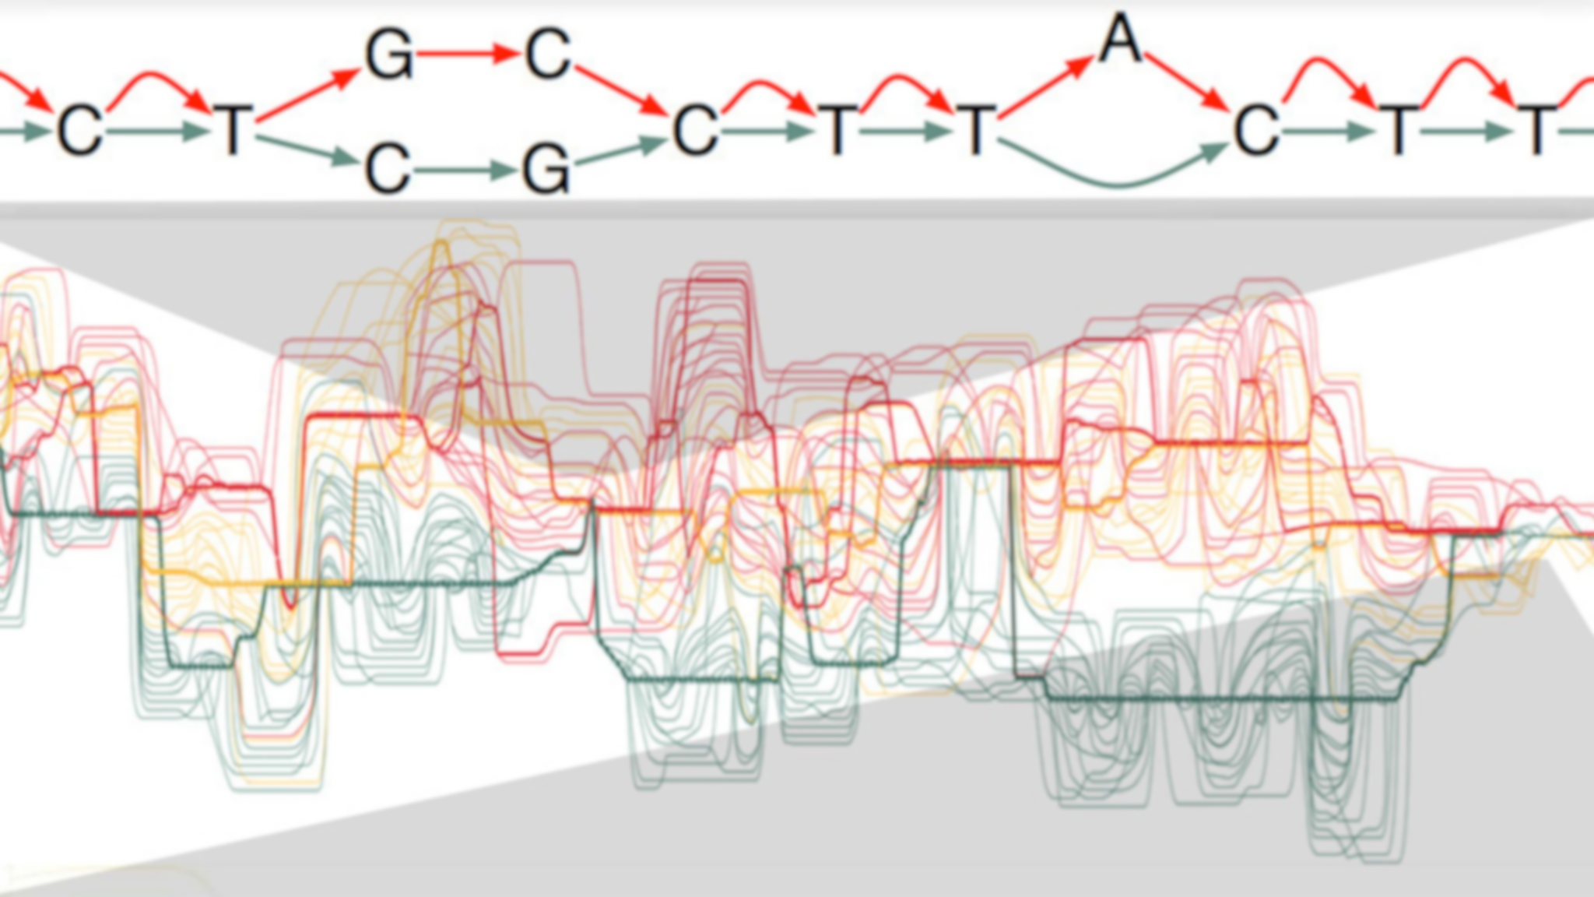
Variant Calling
September 17, 2021 | CMDB Quantitative Biology Lab

Slide 2
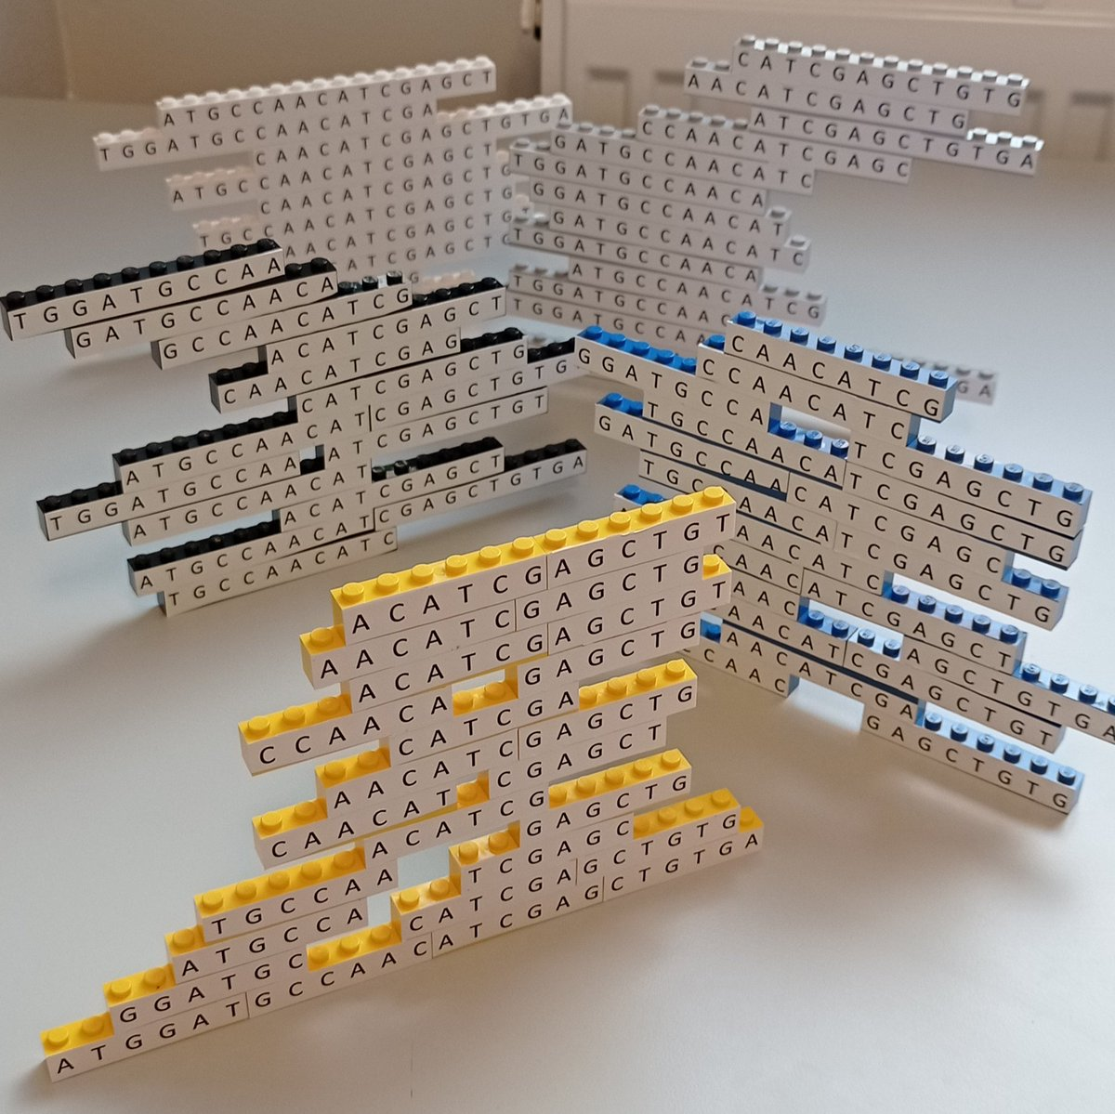

Slide 3
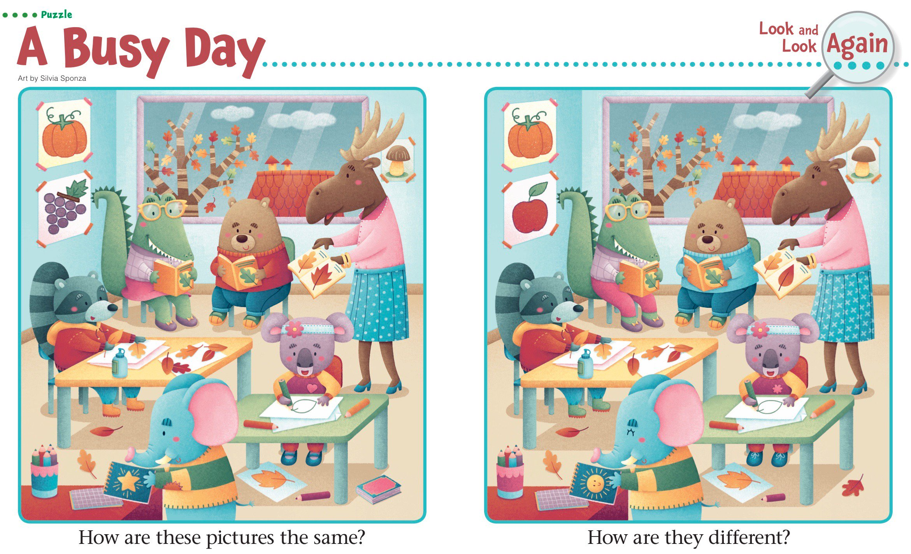

Slide 4

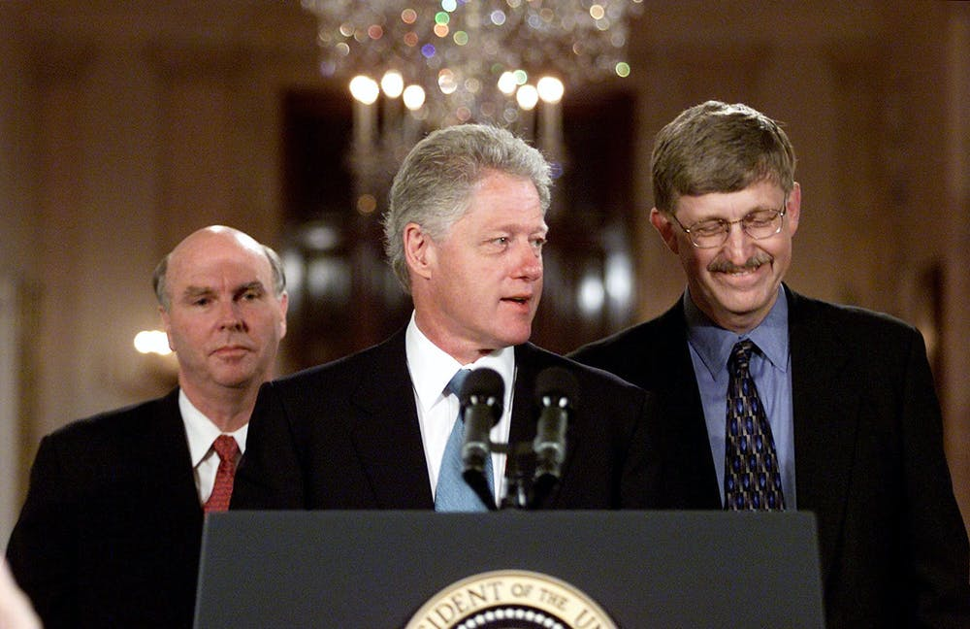

Slide 5
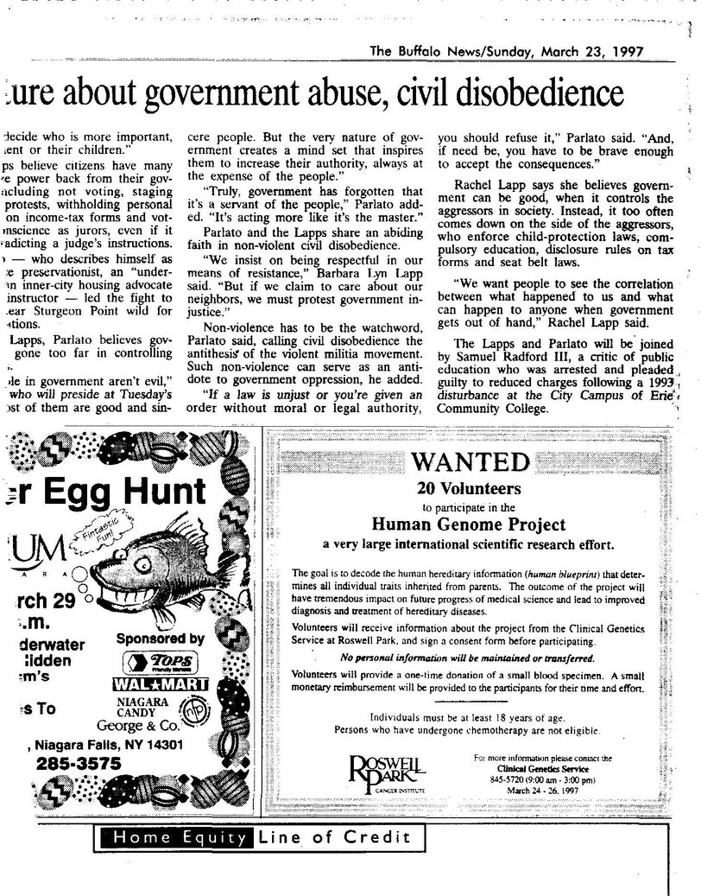

Slide 7
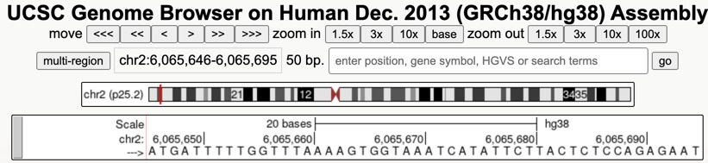

Slide 8

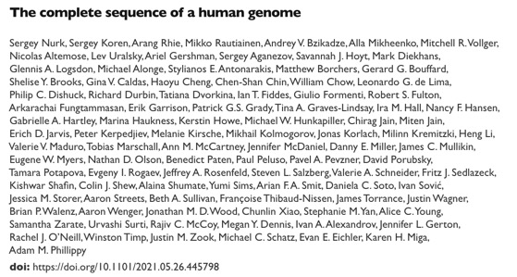

Slide 9
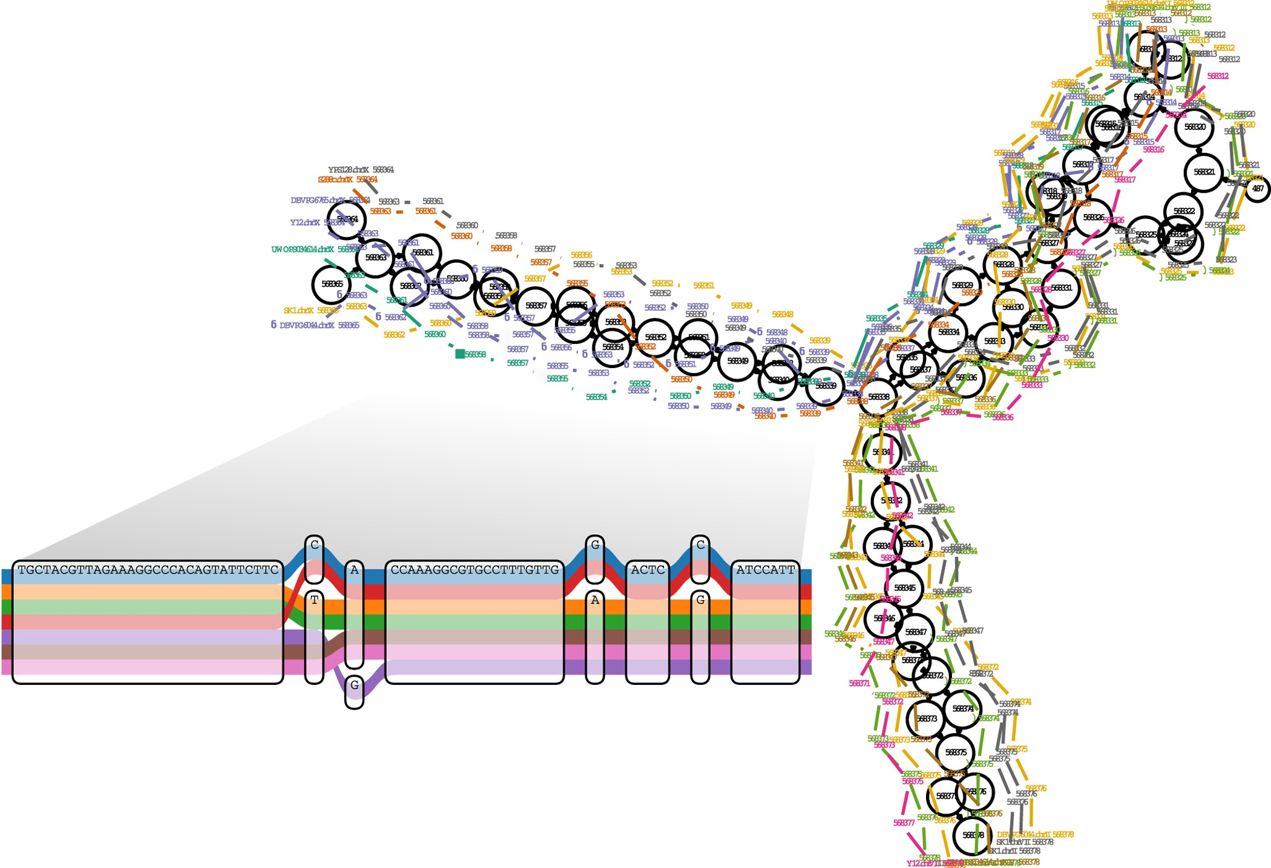
Garrison, E. et al. (2018). Nature biotechnology, 36(9), 875-879.

Slide 10
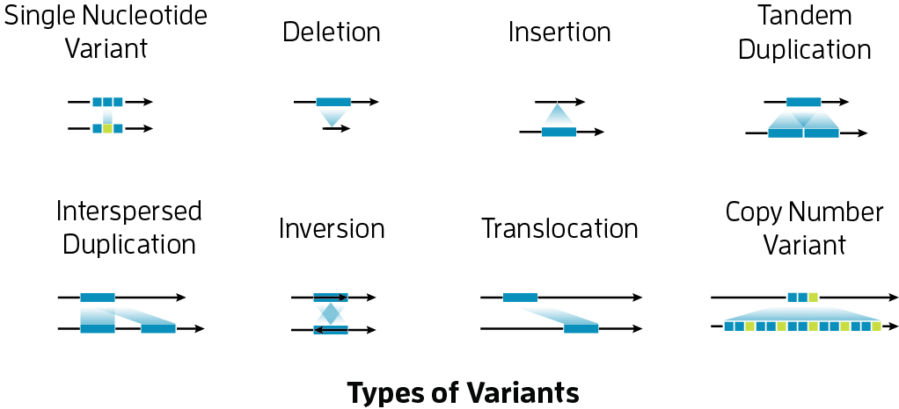
https://www.pacb.com/

Slide 11
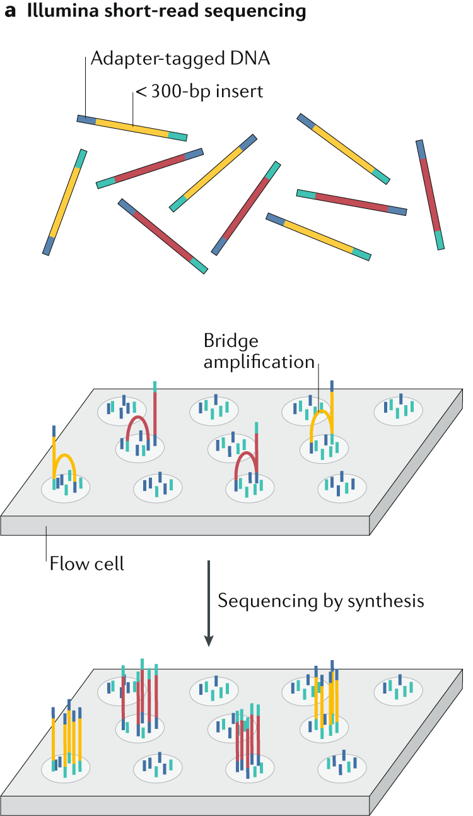
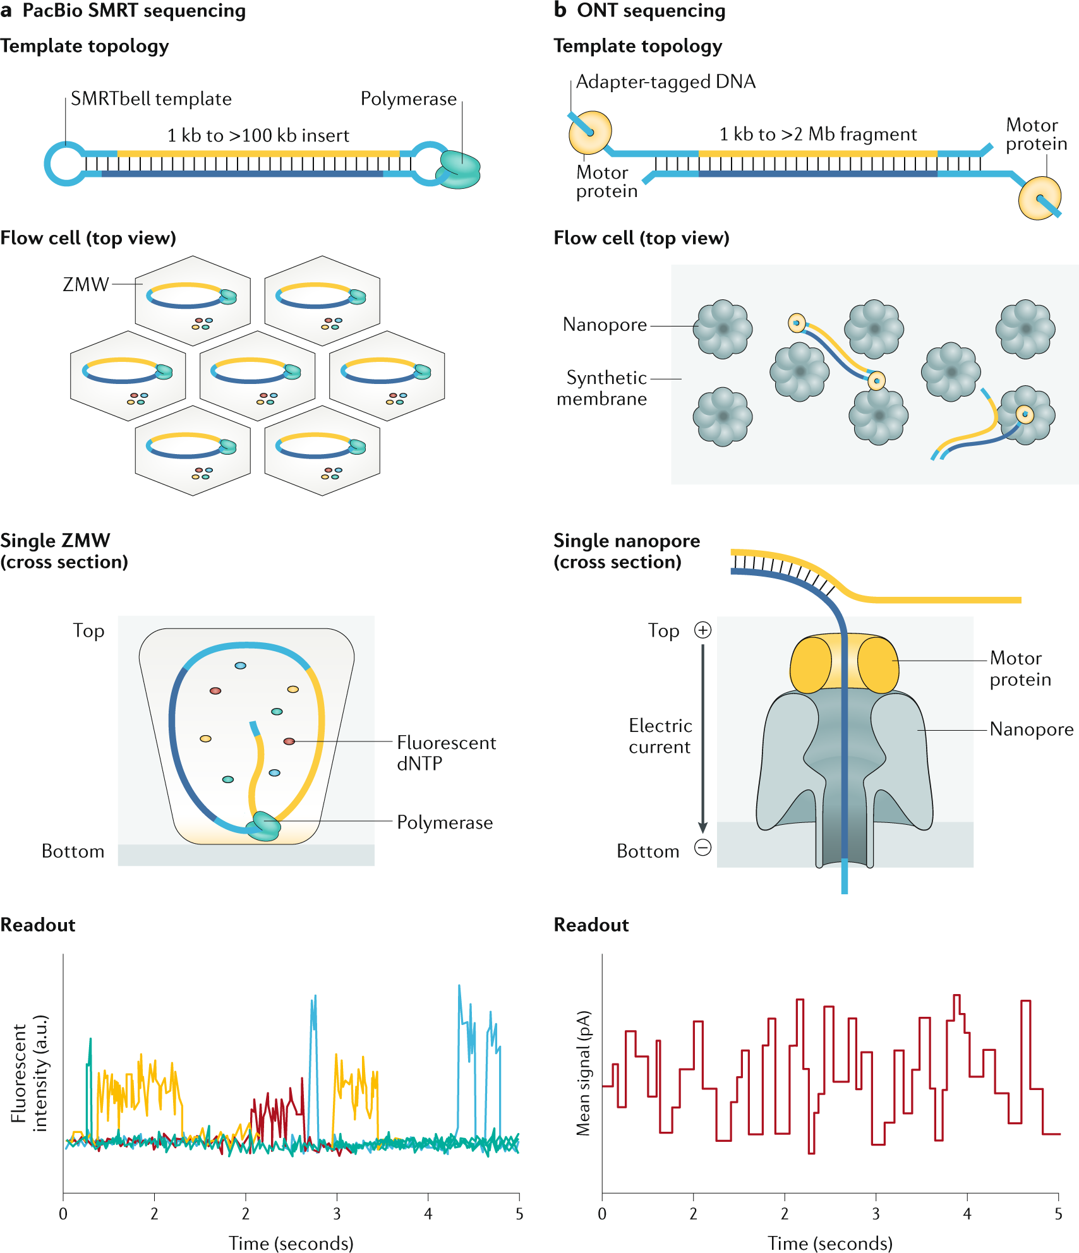
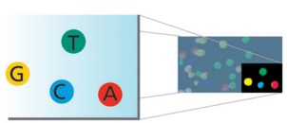
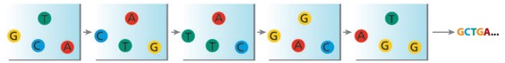
Logsdon, G. A. et al. Nature Reviews Genetics, 21(10), 597-614.

Slide 12
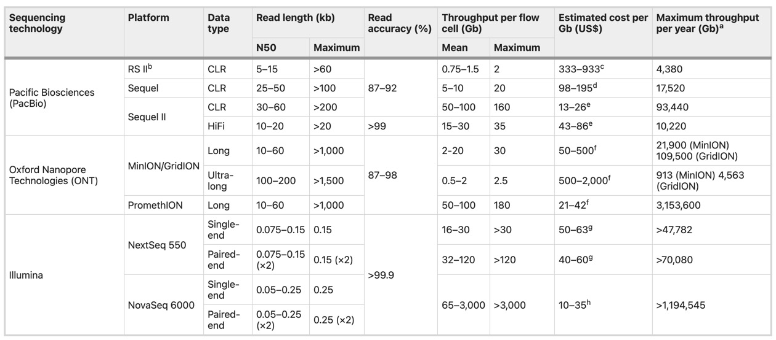
Logsdon, G. A. et al. Nature Reviews Genetics, 21(10), 597-614.

Slide 13
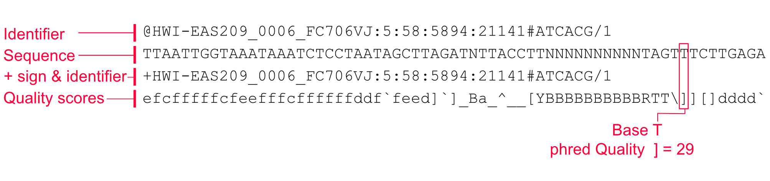
FASTQ: raw sequencing reads

Slide 14
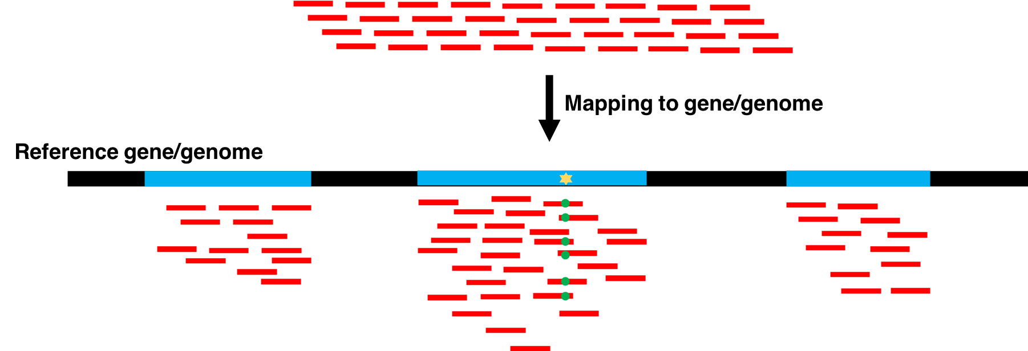
https://training.galaxyproject.org/

Slide 15
Searching for GATTACA
Where is GATTACA in the human genome?
Strategy 1: Brute Force
1 | 2 | 3 | 4 | 5 | 6 | 7 | 8 | 9 | 10 | 11 | 12 | 13 | 14 | 15 | …
T | G | A | T | T | A | C | A | G | A | T | T | A | C | C | …
 | G | A | T | T | A | C | A
Match at offset 2

Slide 16













Searching for GATTACA
<20 guesses to find 424242
1
1
How did I know that?
?
?
250k
?
375k
375k
406.25k
?
?
?
424241
…
437.5k
437.5k
424243
500k 500k 500k
How many times can I cut 1,000,000 in half?
x = 19.93 => 20
How many times can I cut 2,000,000 in half?
x = 20.93 => 21
How many times can I cut 1,000,000,000 in half?
x = 29.89 => 30
How many times can I cut 3,000,000,000 in half?
x = 31.48 => 32
1M

Slide 17








What if we need to check many queries?
We don't need to check every page of the phone book to find 'Schatz'
Sorting alphabetically lets us immediately skip 96% (25/26) of the book
without any loss in accuracy
Sorting the genome: Suffix Array (Manber & Myers, 1991)
– Sort every suffix of the genome
Split into n suffixes
Sort suffixes alphabetically
[Challenge Question: How else could we split the genome?]

Slide 18


Create an Index
GATTACA
All suffixes
Suffix array
GATTACA ATTACA TTACA TACA ACA
CA A
A ACA
ATTACA CA
GATTACA TACA
TTACA

Slide 19
Create an Index
GATTACA
All suffixes
Suffix array # p
GATTACA | 1 7 | A
ATTACA | 2 5 | ACA
TTACA | 3 3 | ATTACA
TACA | 4 6 | CA
ACA | 5 1 | GATTACA
CA | 6 4 | TACA
A | 7 3 | TTACA

Slide 20
Create an Index
GATTACA
All suffixes
Suffix array # p
1 7
2 5
3 3
4 6
5 1
6 4
7 3
GATTACA ATTACA TTACA TACA ACA
CA A

Slide 21

Strategy 2: Binary search
Compare to the middle, refine as higher or lower
Lo
Searching for GATTACA
Lo = 1; Hi = 15;
# | Sequence | Pos
1 | ACAGATTACC… | 6
2 | ACC… | 13
3 | AGATTACC… | 8
4 | ATTACAGATTACC… | 3
5 | ATTACC… | 10
6 | C… | 15
7 | CAGATTACC… | 7
8 | CC… | 14
9 | GATTACAGATTACC… | 2
10 | GATTACC… | 9
11 | TACAGATTACC… | 5
12 | TACC… | 12
13 | TGATTACAGATTACC… | 1
14 | TTACAGATTACC… | 4
15 | TTACC… | 11
Hi

Slide 22

Strategy 2: Binary search
Compare to the middle, refine as higher or lower
Lo
Searching for GATTACA
Lo = 1; Hi = 15; Mid = (1+15)/2 = 8
Middle = Suffix[8] = CC
 | # | Sequence | Pos
 | 1 | ACAGATTACC… | 6
 | 2 | ACC… | 13
 | 3 | AGATTACC… | 8
 | 4 | ATTACAGATTACC… | 3
 | 5 | ATTACC… | 10
 | 6 | C… | 15
 | 7 | CAGATTACC… | 7
 | 8 | CC… | 14
 | 9 | GATTACAGATTACC… | 2
 | 10 | GATTACC… | 9
 | 11 | TACAGATTACC… | 5
 | 12 | TACC… | 12
 | 13 | TGATTACAGATTACC… | 1
 | 14 | TTACAGATTACC… | 4
 | 15 | TTACC… | 11
Hi

Slide 23

Strategy 2: Binary search
Compare to the middle, refine as higher or lower
Lo
Searching for GATTACA
Lo = 1; Hi = 15; Mid = (1+15)/2 = 8
Middle = Suffix[8] = CC
=> Higher: Lo = Mid + 1
 | # | Sequence | Pos
 | 1 | ACAGATTACC… | 6
 | 2 | ACC… | 13
 | 3 | AGATTACC… | 8
 | 4 | ATTACAGATTACC… | 3
 | 5 | ATTACC… | 10
 | 6 | C… | 15
 | 7 | CAGATTACC… | 7
 | 8 | CC… | 14
 | 9 | GATTACAGATTACC… | 2
 | 10 | GATTACC… | 9
 | 11 | TACAGATTACC… | 5
 | 12 | TACC… | 12
 | 13 | TGATTACAGATTACC… | 1
 | 14 | TTACAGATTACC… | 4
 | 15 | TTACC… | 11
Hi

Slide 24

Strategy 2: Binary search
Compare to the middle, refine as higher or lower
Searching for GATTACA
Lo = 1; Hi = 15; Mid = (1+15)/2 = 8
Middle = Suffix[8] = CC
=> Higher: Lo = Mid + 1
Lo = 9; Hi = 15;
Lo
# | Sequence | Pos
9 | GATTACAGATTACC… | 2
10 | GATTACC… | 9
11 | TACAGATTACC… | 5
12 | TACC… | 12
13 | TGATTACAGATTACC… | 1
14 | TTACAGATTACC… | 4
15 | TTACC… | 11
1 ACAGATTACC… 6
2 ACC… 13
3 AGATTACC… 8
4 ATTACAGATTACC… 3
5 ATTACC… 10
6 C… 15
7 CAGATTACC… 7
8 CC… 14
Hi

Slide 25
Strategy 2: Binary search
Compare to the middle, refine as higher or lower
Searching for GATTACA
Lo = 1; Hi = 15; Mid = (1+15)/2 = 8
Middle = Suffix[8] = CC
=> Higher: Lo = Mid + 1
 | # | Sequence | Pos
 | 9 | GATTACAGATTACC… | 2
 | 10 | GATTACC… | 9
 | 11 | TACAGATTACC… | 5
 | 12 | TACC… | 12
 | 13 | TGATTACAGATTACC… | 1
 | 14 | TTACAGATTACC… | 4
 | 15 | TTACC… | 11
1 ACAGATTACC… 6
2 ACC… 13
3 AGATTACC… 8
4 ATTACAGATTACC… 3
5 ATTACC… 10
6 C… 15
7 CAGATTACC… 7
8 CC… 14
Lo = 9; Hi = 15; Mid = (9+15)/2 = 12
Middle = Suffix[12] = TACC
Lo
Hi

Slide 26

Strategy 2: Binary search
Compare to the middle, refine as higher or lower
Searching for GATTACA
Lo = 1; Hi = 15; Mid = (1+15)/2 = 8
Middle = Suffix[8] = CC
=> Higher: Lo = Mid + 1
# | Sequence | Pos
9 | GATTACAGATTACC… | 2
10 | GATTACC… | 9
11 | TACAGATTACC… | 5
1 ACAGATTACC… 6
2 ACC… 13
3 AGATTACC… 8
4 ATTACAGATTACC… 3
5 ATTACC… 10
6 C… 15
7 CAGATTACC… 7
8 CC… 14
Lo = 9; Hi = 15; Mid = (9+15)/2 = 12
Middle = Suffix[12] = TACC
=> Lower: Hi = Mid - 1
Lo
Lo = 9; Hi = 11;
Hi
12 TACC… 12
13 TGATTACAGATTACC… 1
14 TTACAGATTACC… 4
15 TTACC… 11

Slide 27

Strategy 2: Binary search
Compare to the middle, refine as higher or lower
Searching for GATTACA
Lo = 1; Hi = 15; Mid = (1+15)/2 = 8
Middle = Suffix[8] = CC
=> Higher: Lo = Mid + 1
 | # | Sequence | Pos
 | 9 | GATTACAGATTACC… | 2
 | 10 | GATTACC… | 9
 | 11 | TACAGATTACC… | 5
1 ACAGATTACC… 6
2 ACC… 13
3 AGATTACC… 8
4 ATTACAGATTACC… 3
5 ATTACC… 10
6 C… 15
7 CAGATTACC… 7
8 CC… 14
Lo = 9; Hi = 15; Mid = (9+15)/2 = 12
Middle = Suffix[12] = TACC
=> Lower: Hi = Mid - 1
Lo
Lo = 9; Hi = 11; Mid = (9+11)/2 = 10
Middle = Suffix[10] = GATTACC
Hi
12 TACC… 12
13 TGATTACAGATTACC… 1
14 TTACAGATTACC… 4
15 TTACC… 11

Slide 28



Strategy 2: Binary search
Compare to the middle, refine as higher or lower
Searching for GATTACA
Lo = 1; Hi = 15; Mid = (1+15)/2 = 8
Middle = Suffix[8] = CC
=> Higher: Lo = Mid + 1
# | Sequence | Pos
9 | GATTACAGATTACC… | 2
1 ACAGATTACC… 6
2 ACC… 13
3 AGATTACC… 8
4 ATTACAGATTACC… 3
5 ATTACC… 10
6 C… 15
7 CAGATTACC… 7
8 CC… 14
Lo = 9; Hi = 15; Mid = (9+15)/2 = 12
Middle = Suffix[12] = TACC
=> Lower: Hi = Mid - 1
Lo Hi
Lo = 9; Hi = 11; Mid = (9+11)/2 = 10
Middle = Suffix[10] = GATTACC
=> Lower: Hi = Mid - 1
Lo = 9; Hi = 9;
10 GATTACC… 9
11 TACAGATTACC… 5
12 TACC… 12
13 TGATTACAGATTACC… 1
14 TTACAGATTACC… 4
15 TTACC… 11

Slide 29

Strategy 2: Binary search
Compare to the middle, refine as higher or lower
Searching for GATTACA
Lo = 1; Hi = 15; Mid = (1+15)/2 = 8
Middle = Suffix[8] = CC
=> Higher: Lo = Mid + 1
 | # | Sequence | Pos
 | 9 | GATTACAGATTACC… | 2
1 ACAGATTACC… 6
2 ACC… 13
3 AGATTACC… 8
4 ATTACAGATTACC… 3
5 ATTACC… 10
6 C… 15
7 CAGATTACC… 7
8 CC… 14
Lo = 9; Hi = 15; Mid = (9+15)/2 = 12
Middle = Suffix[12] = TACC
=> Lower: Hi = Mid - 1
Lo Hi
Lo = 9; Hi = 11; Mid = (9+11)/2 = 10
Middle = Suffix[10] = GATTACC
=> Lower: Hi = Mid - 1
Lo = 9; Hi = 9; Mid = (9+9)/2 = 9
Middle = Suffix[9] = GATTACA…
=> Match at position 2!
10 GATTACC… 9
11 TACAGATTACC… 5
12 TACC… 12
13 TGATTACAGATTACC… 1
14 TTACAGATTACC… 4
15 TTACC… 11

Slide 30
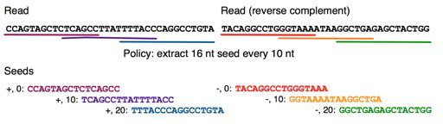
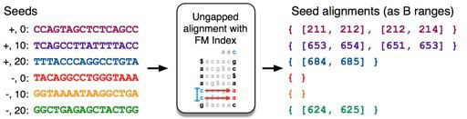
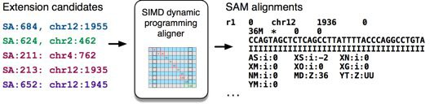
1. Split read into segments
2. Lookup each segment and prioritize
3. Evaluate end-to-end match
Langmead, B., & Salzberg, S. L. (2012). Nature methods, 9(4), 357-359.

Slide 31
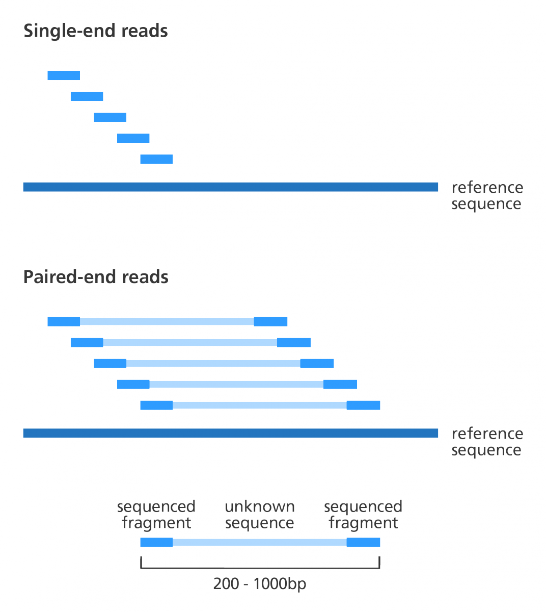
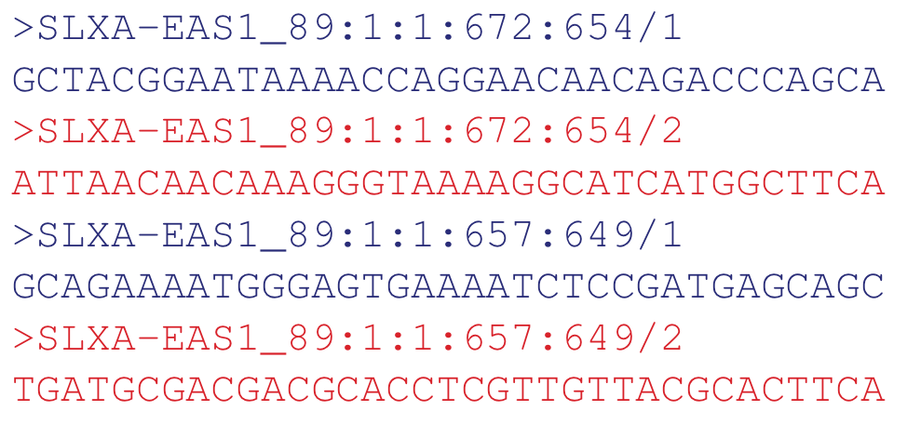

Slide 32
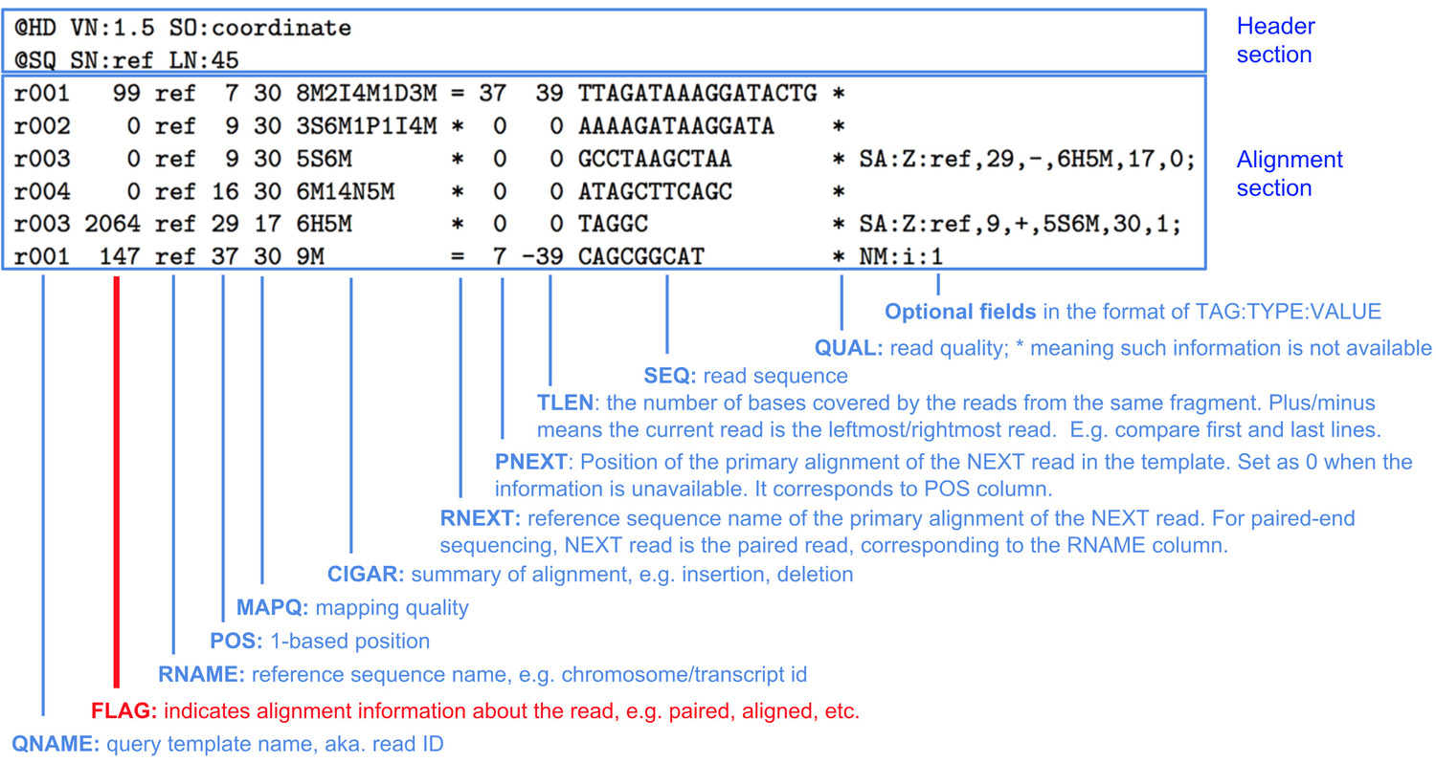
SAM/BAM: alignments of reads to the reference genome
https://du-bii.github.io/

Slide 33
https://igv.org/app/

Slide 34
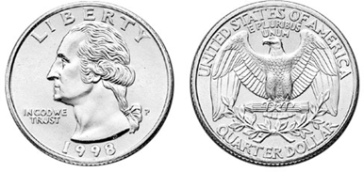
The Binomial Distribution: Adventures in Coin Flipping
P(heads) = 0.5
P(tails) = 0.5
Aaron Quinlan

Slide 35
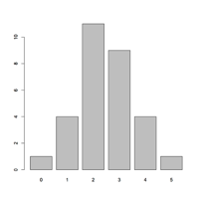
What is the distribution of tails (alternate alleles) do we expect to see after 5 tosses (sequence reads)?
Number of experiments
R code:
barplot(table(rbinom(30, 5, 0.5)))
30 experiments (students tossing coins) 5 tosses each
Probability of Tails
Number of "tails"

Slide 36
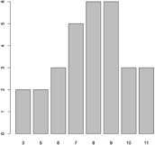
What is the distribution of tails (alternate alleles) do we expect to see after 15 tosses (sequence reads)?
Number of experiments
R code:
barplot(table(rbinom(30, 15, 0.5)))
30 experiments (students tossing coins) 15 tosses each
Probability of Tails
Number of "tails"

Slide 37
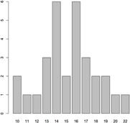
What is the distribution of tails (alternate alleles) do we expect to see after 30 tosses (sequence reads)?
Number of experiments
R code:
barplot(table(rbinom(30, 30, 0.5)))
30 experiments (students tossing coins) 30 tosses each
Probability of Tails
Number of "tails"

Slide 38
What is the distribution of tails (alternate alleles) do we expect to see after 30 tosses (sequence reads)?
Number of experiments
4e+05
R code:
3e+05
barplot(table(rbinom(3e6, 30, 0.5)))
3M experiments (students tossing coins) 30 tosses each
Probability of Tails
2e+05
1e+05
0e+00
2 3 4 5 6 7 8 9 10 12 14 16 18
20
22
24
26
28
Number of "tails"

Slide 39
So, with 30 tosses, we are very likely to see an approximately even mix of alternate and reference alleles at a heterozygous locus
Number of experiments
4e+05
This is why at least a "30X" (30 fold sequence coverage) genome is recommended: it confers sufficient power to distinguish heterozygous alleles and from mere sequencing errors
3e+05
2e+05
1e+05
0e+00
2 3 4 5 6 7 8 9 10 12 14 16 18
20
22
24
26
28
Number of "tails"

Slide 40
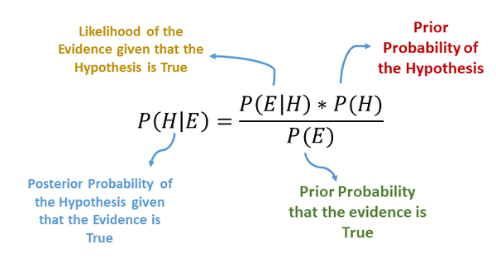
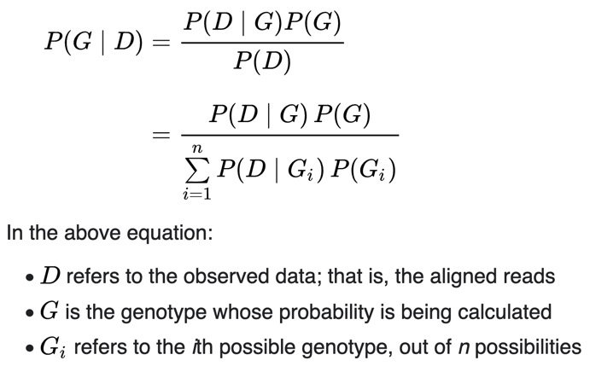
Bayes’ Theorem
https://laptrinhx.com/naive-bayes-algorithm-4229686008/

Slide 41
Bayesian Genotyping
https://laptrinhx.com/naive-bayes-algorithm-4229686008/

Slide 42
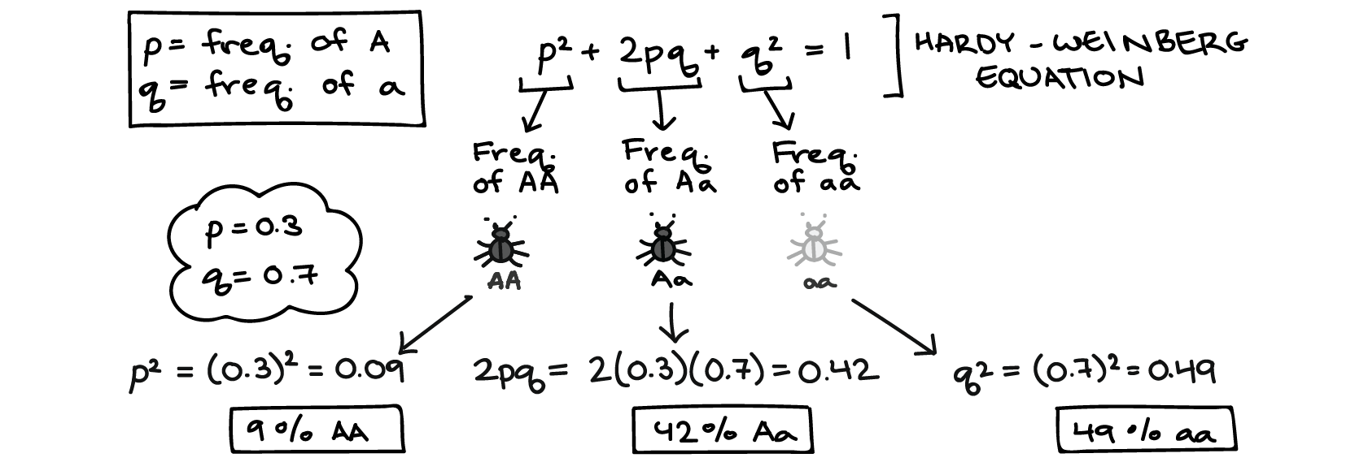
https://www.khanacademy.org/

Slide 43
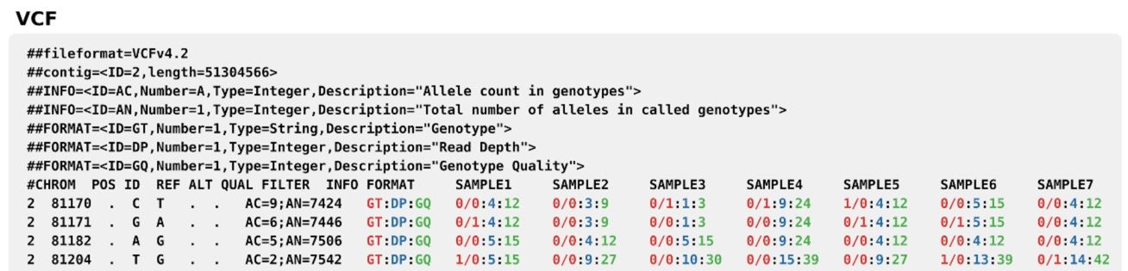
…

Slide 44
